Slide 1
Computer
Detailed Definition
Functions
Long form
Operating System

Slide 2
Welcome
Operating System

Slide 3

Agenda
Computer

Slide 4




What is Computer
Computer is a big bird that I saw in Jungle!!!!!!!!!!!!!!!!!
Or
Bla…Bla….. Bla-------------------
Computer is an electronic device which perform arithmetic and logical operation in fast manner
But this can be done by small electronic devices like Phone, Gadgets, calculators…etc
Then question comes what actually computer is
So something need to be different and what is different
Electronic Device[Combination of devices]
Perform :Arithmetic & logical operation
Accept: some inputs (Valid)
Data Processing
Data Storing capacity
Produce the output
And many More…..
Computer Functions
Data Processing
Data Storing
Data Movement[place to place]
Data control[syn, direct]

Slide 5
What is Computer
Compute
Processing or Computing
But What to process
Number to process
Arithmetic processing
Symbol to Processing
Logical processing
Audio/Video processing
Multimedia processing
Er –
To process variety of data we need communication
Communication
Telephone communication
Data communication
Voice communication
N/W communication
Commonly Operating Machine Particularly Used for Technical , Educational and Research Purpose

Slide 6
Thank You
We will meet Soon!!!!!!!!!!

Slide 7
Computer System
Hardware/Software
Software Hierarchy
Application & System S/W
Operating System

Slide 8
Agenda
Computer System

Slide 9
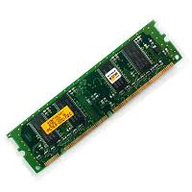
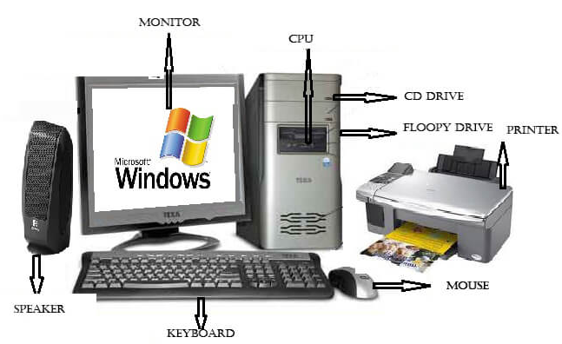
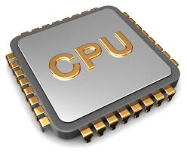
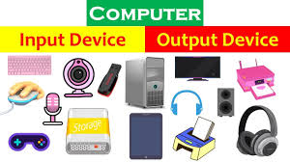
Computer System
CS is collection of object/elements/components
This components are of two types
Hard Ware and Soft Ware
Hard Ware[which describes the physical aspects of a computer]
CPU
MEM
IO

Slide 10
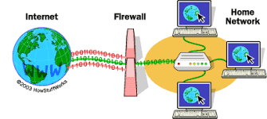

Computer System
All hardware components can interact with each other with the help of software's
“Software is a set of instructions, data or programs used to operate computers and execute specific tasks”
Hierarchy of S/W
Utility S/W
Viruses
Port Scan
Firewall
Application S/W
Database
World
PPT etc

Slide 11
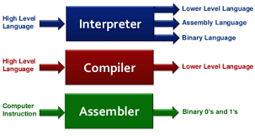
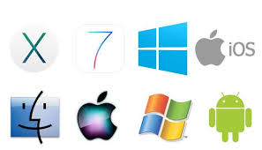
System S/W
System S/W
System software is a type of computer program designed to run a computer's hardware and application programs
System software coordinates the activities and functions of the hardware and software
Translator
Interpreter
Compiler
Assembler
Operating System

Slide 12
Thank You
We will meet Soon!!!!!!!!!!

